Slide 1
Sprint 5 – BUDS
Workflow Management System

Slide 2
Team Roles
Sophie – Scrum Master & help on front/ back-end where needed
Noah B – Front-end development
Noah M and Gavin – Back-end development

Slide 3
Goals For Sprint 5
Implement a report generation function
Create a dashboard page with report generation
Create and streamline interactions between Products and Raw Materials tables
Implement and refine error handling
Work on sizing/ resizing pages and refining other aspects of the GUI

Slide 4
Goals Accomplished
Created interactions between the Products and Raw Materials tables
Created a complete pathway from the Raw Material table to Product table
Created a Dashboard page to showcase report generation
Created a way to generate reports
Began to introduce error handling (not finished)

Slide 5
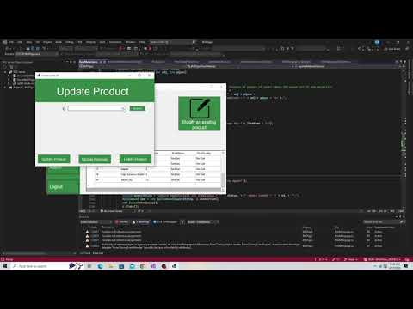
DEMO
Demo
https://youtu.be/s0MJxdHovY0

Slide 6
Software Testing
Why do we test? So that we can find “bugs” in the software before we deliver to the product owner!
Big theme this Sprint – working on error handling for every case
We have been using dynamic testing, or testing the program against real inputs

Slide 7
Challenges
Difficulty finding every hypothetical error case
Resizing every item is time consuming
Finals and other final projects coming up
Difficulty implementing report generation

Slide 8
Future Goals
Condense work from every sprint into one cohesive slideshow
Continue to work on resizing GUI windows
Continue to refine back-end and front-end code, as well as the GUI aesthetics
Finish error handling across application

Slide 9
Questions?

